Slide 1
Subsea Services Inc.
Website Development
Round 2 Comments
12 Sep 2016

Slide 2
Introduction and Summary
SSI requires a revamp of website design.
Round 2 pre-release comments for the website are given in this document.
Round 1 comments are given in PRE-0006-01
Key comments are:
Consistent Header (utilize all white space)
Consistent Footer (utilize all white space)
Picture slider and text
Consistent format and font (Best achieved by using single CSS file for all pages).
The design is almost there. We need the last push for a consistent design before we can issue the website for client comments.

Slide 3
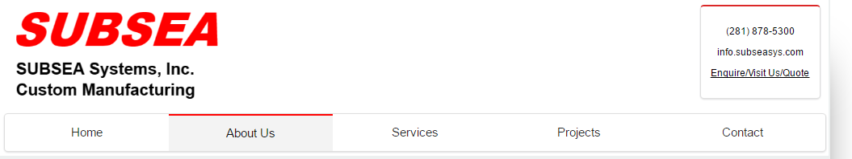
Header - Layout
Existing Design
Please update to below. This will help utilize white space effectively.

Slide 4
Header Details - Logo
Logo
Ideally made out of words or text
Font settings are given below at 100%.
If image is used, it should be SVG (Scalable vector graphics)
http://webdesign.tutsplus.com/articles/getting-started-with-scalable-vector-graphics-svg--webdesign-7515
Ask Ganga for help if you need it. You may need adobe illustrator program or similar
SUBSEA
SUBSEA Systems, Inc.
Custom Manufacturing
Text | Font Type, Size (Medium) | Color
SUBSEA | Arial Black, Bold, CAPS, Italicized, 36 | Std. Red
SUBSEA Systems, Inc. | Arial, Bold, CAPS, -, 13 | Std. Black
Custom Manufacturing | Arial, Bold, -, -, 13 | Std. Black

Slide 5
Header Details - Menu
Menu font and white space in between can be better managed.
Define single .CSS (or other format) file for consistent format across all pages
At 100% zoom (or other user zoom percentage):
The logo, the menu and text fonts should look consistent across all pages
Moving from one page to another, the left, right, top margins should be consistent. Only the page body content changes
Any unnecessary jump will strain the user eyes and take the focus away from the information and website purpose.
Good menu design of active page (Gray background and redline highlight)

Slide 6
Header Details – Contact Details
Decrease the spacing between font.
Give email address a hyperlink so it will load the user’s email form to send an email (such as Gmail, outlook etc.)
Take the hyperlink for “Enquire/Visit US/Quote” to “Contact” page form.

Slide 7
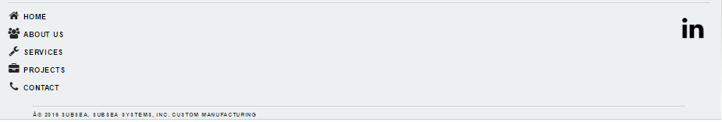
Footer - Layout
Existing Design has too much white (unused) space
Please update to below layout. This will help utilize white space effectively.
Please change copyright text to below and it should be text format:
“A © 2016 SUBSEA System Inc.”

Slide 8
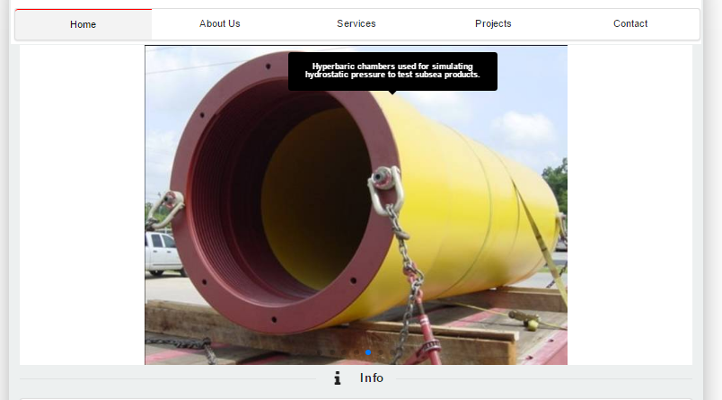
Picture Slider – Boundary Limits
Restrict the picture slider to a particular width as shown below (~75%) and display all pictures to be stretched in these boundaries.
We may need to scale the oddly displayed pictures accordingly in next revision if required.
~75%
100%

Slide 9
Picture Slider – Boundary Limits
Please remove the “I info” space in picture slider. I think it is an error or is there any intention?

Slide 10
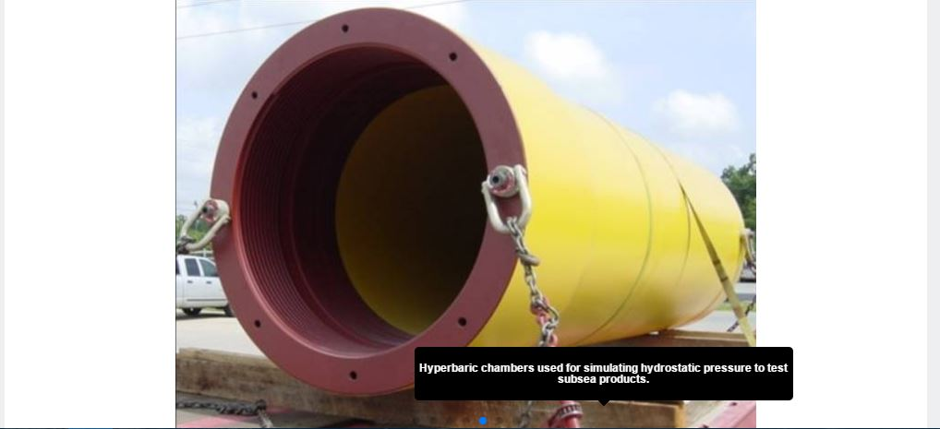
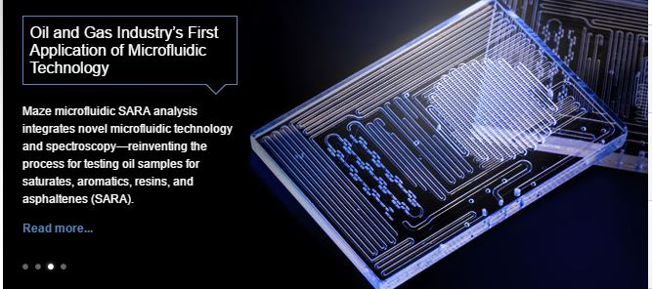
Picture Slider – Text Display
Please provide user options (in code) for placing the matter on the picture. Point us to the code as well so we can vary (play around) the following:
Background colour of the textbox,
Position of the text.
Right top corner
Left top corner
Right bottom corner
Left bottom corner
Font type and size
Text box contents (to fit the picture size etc.)

Slide 11
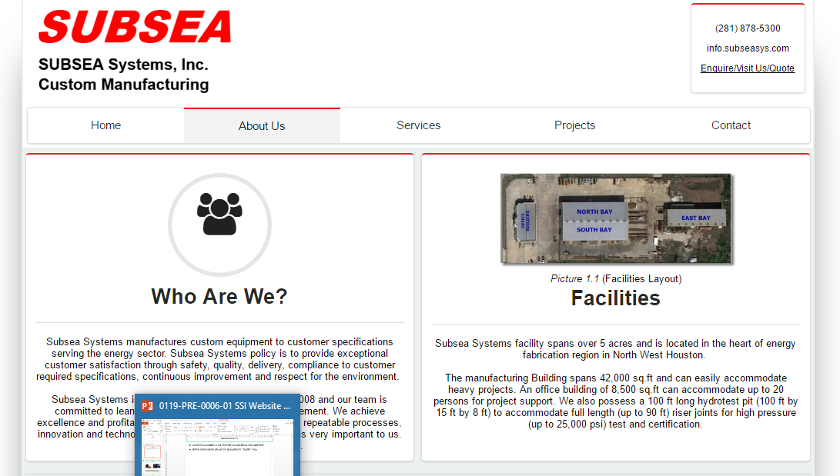
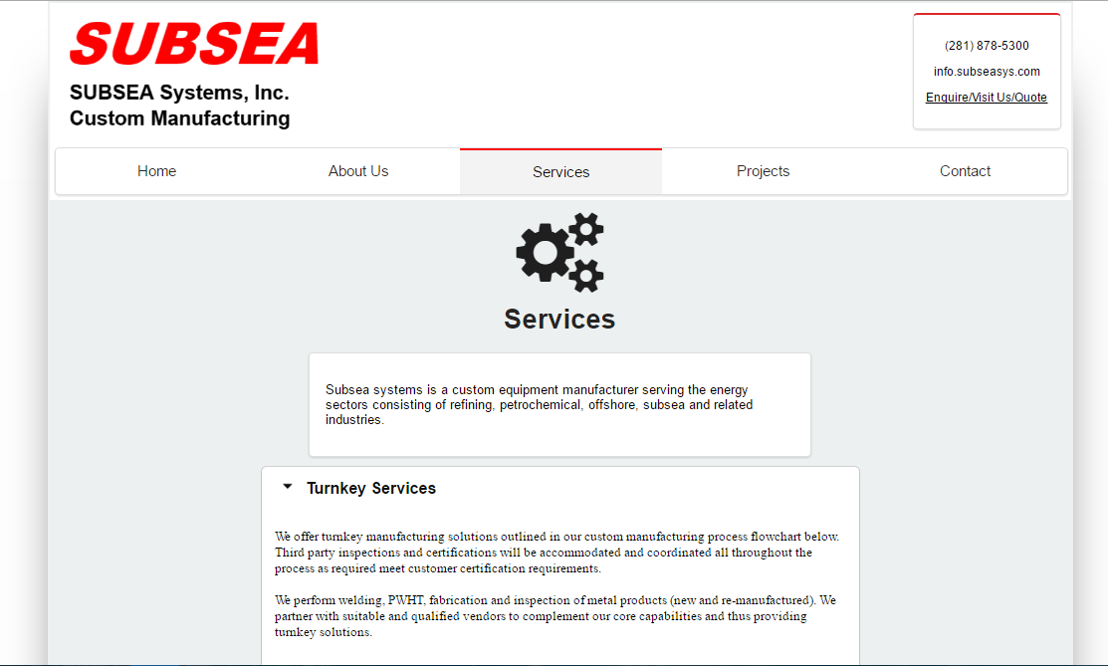
Font Guidelines
All the text present in the website should follow only one font type and size for main text.
All the text content should be formatted in “Justify” only.
Please keep “look and feel” consistent across all pages
For example, the content is aligned to center in left side screenshot. On right side the font is changed in the highlighted area and it is aligned to left.

Slide 12
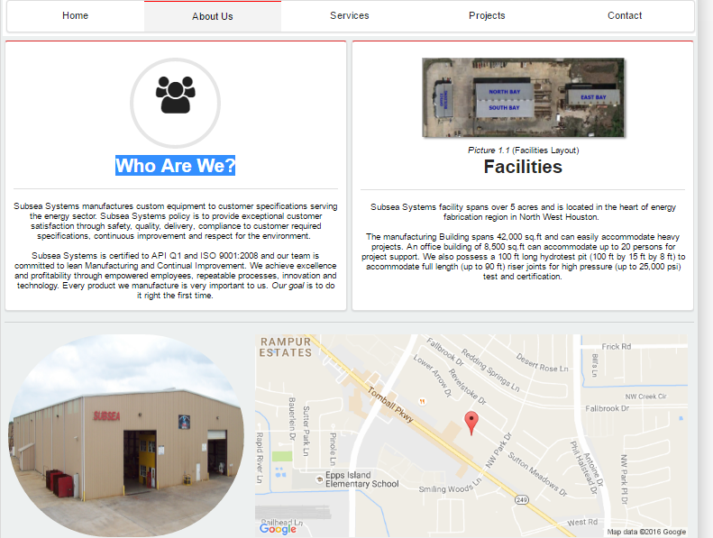
About Us – Graphic Picture
The “Graphic picture” highlighted below is a waste of space. Remove it. We can use this space wisely for important text relevant to business.
Please do this removal consistently for other pages such as “Services” and “projects”

Slide 13
About Us – Who We Are
Change “Who Are We?” to “Who We Are”

Slide 14
About Us – remove map and facility
Please remove or delete map and facility picture from this page.

Slide 15
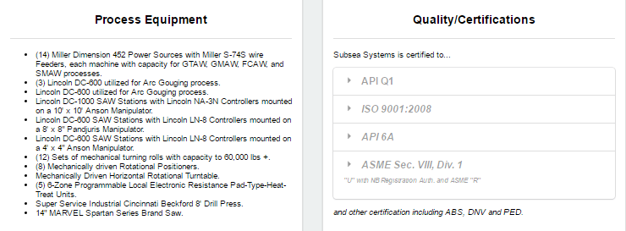
About Us – Format
Follow top to down format as shown
Simple design
No need of fancy boundaries.
Easy to read
All white background (easy to read black text)
No grey background
Move “top view picture” below “Facilities” heading so people know they are looking at facility.
Move headings to “align left”
Text (font type and size) consistency

Slide 16
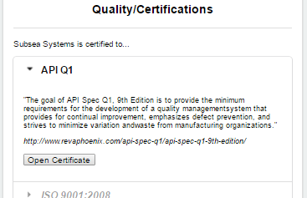
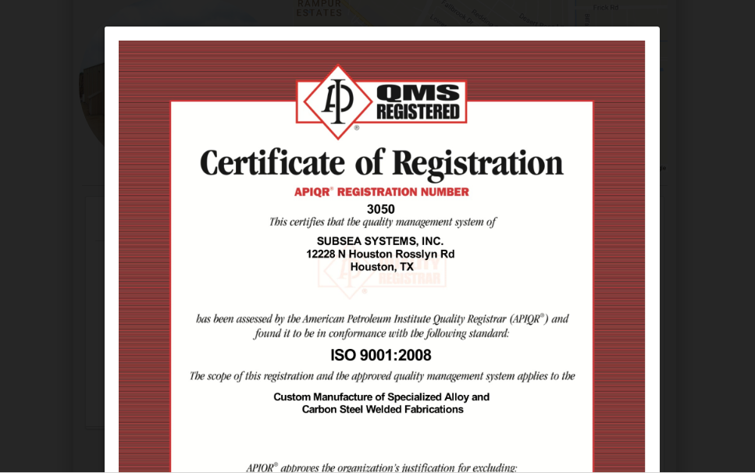
About Us – Quality
Remove external links. They are difficult to mange
DO NOT use collapsible menu style
Show all text
This way, people can read in one go.
Change “Open Certificate” to view Certificate”
Also:
Show only 50% of the existing size
Make the background more visible (or foreground more transparent) so people can see back page and it will be obvious that they click on it to go back.

Slide 17
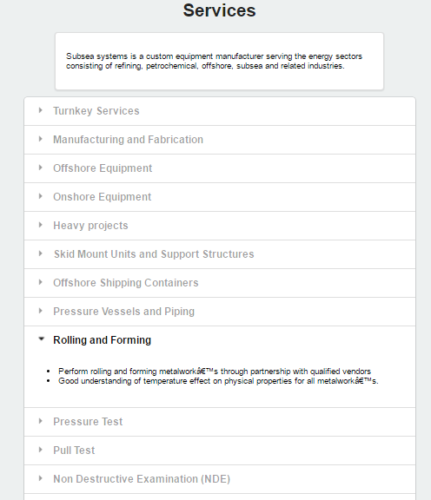
Services – Format
Remove “Graphic Picture”
Use all the margin of page wisely
DO NOT use collapsible menu style
Show them as
Heading
Text
Heading
Text
…
This way, people can read all services without too much clicking/unclicking. This is the most important business page
Remove gray color.

Slide 18
Projects – Order
Move “Customers” above “Projects”
Remove customer logos. We need to get permission from customers to do so. Also, finding the latest logos for every client is a painful process and we will only draw more criticism.

Slide 19
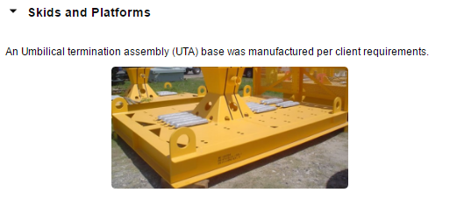
Projects – Format
Remove “Graphic Picture”
Use all the margin of page wisely
DO NOT use collapsible menu style
Show them as:
Heading
Picture on left (60% width)
Text on right (40% width)
Heading
Picture on left (60% width)
Text on right (40% width)
…
This way, people can read in one go with out too much clicking.
An Umbilical termination assembly (UTA) base was manufactured per client requirements.

Slide 20
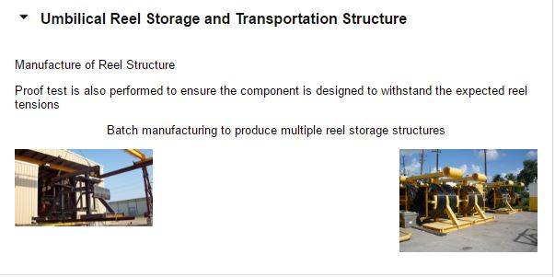
Projects – 2 Pictures
In projects page the images are not so consistent. The length and breadth of the images are different, please adjust the images accordingly and update the page.
The below screenshot is an example for inconsistent text and image sizes.
The picture on the left side is having small height where as the picture on the right hand side is larger height
Please make the pictures width consistent and place one below the other with small space in between to distinguish. (see below right )
Manufacture of Reel Structure
Proof test is also performed to ensure the component is designed to withstand the expected reel tensions
Batch manufacturing to produce multiple reel storage structures

Slide 21
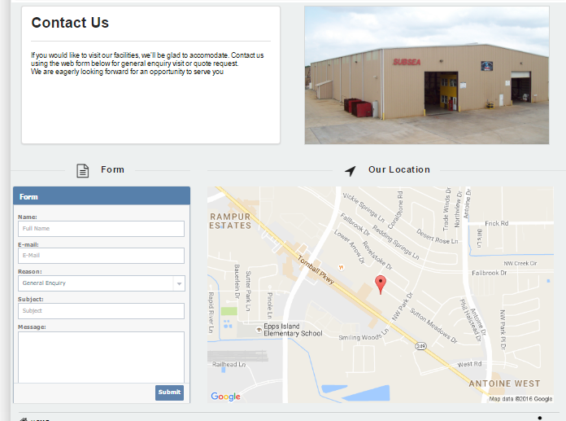
Contact – Format
Make it flow from top to bottom. Right now, it looks like the 4 blocks are disconnected. I suggest the following changes:
Remove grey background.
Decrease the map width from 60% to 40%
Form looks like a Facebook design. Can you use gray background instead of blue to more seem like Subsea design?
Increase width of picture from 40 to 60%
Consistent font size and design for headings and text will greatly help

Slide 22
THANK YOU
For the opportunity to serve!

Slide 23
Document Revision History
01 | Round 2 comments. Round 1 comments in PRE-0006-01 | 12 Sept 2016 |  | GSY | VA
Rev | Description | Date |  | Author | Checked | Approved
Document No: |  |  | Client Ref:
0119-PRE-0007-01 |  |  | n/a

